Slide 1
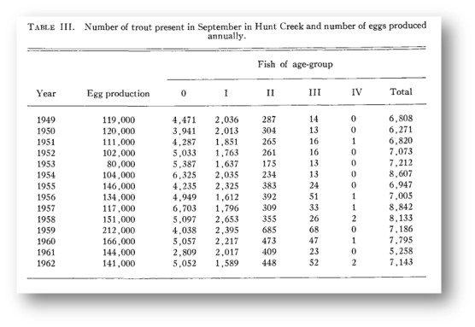

The Stream Model
BK data from Hunt Creek (McFadden et al. 1967) remarkably similar to Pikes Fork ID (Meyer et al. 2006)
Age structured model in RAMAS

Slide 2
Stream Model Parameters
Age | n₀ | S_{j} | SD_{S} | f_{j} | SD_{f} | Sel_{j} | K
Stream model
0 | 5,052 | 0.425 | 0.072 | 0 | 0 | 0.495 | 6,641
1 | 1,589 | 0.175 | 0.042 | 1.497 | 0.508 | 0.909 | 2,822
2 | 448 | 0.086 | 0.043 | 5.110 | 1.956 | 0.948 | 493
3 | 52 | 0.023 | 0.032 | 11.710 | 4.955 | 0.975 | 43
4 | 2 |  |  | 11.743 | 19.655 | 0.984 | 1

Slide 3
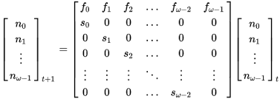
Leslie Matrix Calcs
Are about fecundities and survival by age
… and eigenvectors and eigenvalues

Slide 4

The Ricker Model Population growth treated as a density dependent function
K = 10,000 total fish @ 1,000 per stream k
(Peterson et al. 2004, Meyer et al. 2006)
R₀ = 1.878
(McFadden et al. 1967)
1000 replicates, Upper and Lower Limits = 1.96 SD

Slide 5
Stream Matrix Model
Add Trojan Super-Males
K
n
0
6,641
0
1.4967
5.11
11.71
11.743
5,052
2,822
0.425
1,589
493
<=
0.175
×
448
43
0.086
52
1
0.023
2
±
0
0.5081
1.9563
4.9555
19.655
0.072
0.042
Subtract
Normal
Males
0.043
0.032

